Slide 1
How to Improve/Critique your Images (with a preview of the SCC judging process)
Frank Zaremba, MNEC
Simsbury Camera Club

Slide 2
There are no bad pictures;
that's just how your face looks sometimes
Abraham Lincoln

Slide 3
SCC Calibration Image

Slide 4
NECCC Rule Changes
12. Capture of all photographs as well as any manipulation must be performed by the competitor.
Note that all participants have an obligation to act in an ethical manner when preparing images for use in these competitions.
There is a rule that prohibits adding, moving, or deleting an element in the nature category.
There is a rule in the pictorial category that states that all elements of a composite image must have been captured by the photographer.
There is a rule that a photograph may not be renamed so that it can be entered a second time.
There is no objective way that we can enforce these rules so we are relying on the honesty of the competitors and the club representatives.

Slide 5
NECCC Rule Changes
17. Composite photographs are acceptable in the pictorial/Open category as long as all elements included are the entering photographer’s own work. Commercial clip art, commercially available textures, parts of commercial photographic collections, or the work of another photographer may not be included.
Artwork or computer graphics created by the photographer may be incorporated as long as the photographic content predominates.
Use of filters, such as those in Photoshop or third party plug-ins such as those by NIK or TOPAZ to create or modify such elements are allowed and is not considered a violation of the ethics statement.
However, when using plug-ins any texture applied by the software must be one taken by the photographer. Textures supplied with the plug-in’s are copyrighted by software provider or other photographers who supplied them.

Slide 6
For all categories, all elements of the image, including textures, must be the work of the maker.
For all categories, except creative, any adjustment/change to an image must appear natural.
The SCC follows the:
PSA & NECCC definitions for Nature and Travel.
NECCC definition of Open-Pictorial for Open, Portrait and Creative

Slide 7
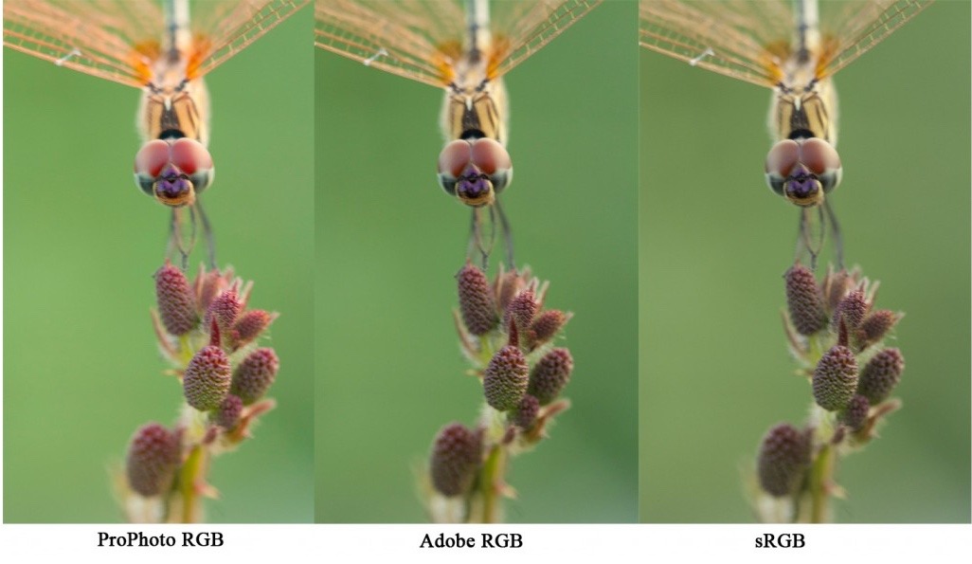
Image Sizing
Images must meet the following requirements
Maximum Image Height 1050 pixels
Maximum Image Width 1400 pixels
Maximum File Size 1200 kb (Kilobytes)
Color Space of sRGB, NOT PROPHOTO RGB or Adobe RGB
Suggested 72 dpi

Slide 8
NATURE ADJUSTMENTS
ALLOWED IN NATURE IMAGES
EXPOSURE ADJUSTMENT (SELECTIVE AND GLOBAL)
ADJUST HIGHLIGHT AND SHADOW DETAIL
ADJUST CONTRAST
WHITE BALANCE / COLOR CORRECTION
(HDR ALLOWED FOR ANY AND ALL OF THE ABOVE)
BLACK & WHITE CONVERSION (GRAYSCALE ONLY)
ADJUST SATURATION
DUST SPOT REMOVAL
NOISE REMOVAL
FLARE REMOVAL
STRAIGHTENING
CROPPING
REVERSING (A.K.A. FLIPPING HORIZONTAL - USE CAUTION ON SCENICS)
RESIZING
SHARPENING (INCLUDING FOCUS LAYERING)
ALL ALLOWED ADJUSTMENTS MUST LOOK NATURAL
ADJUSTMENTS NOT ALLOWED IN NATURE IMAGE
ADDING OR REMOVING IMAGE ELEMENTS
BLURRING BACKGROUNDS

Slide 9
SCC Guidelines can be found on our Website
https://www.simsburycameraclub.com/guidelines

Slide 10
Maximim Image size is now 1400wide for Landscape formated Images and 1050height for Portarit formated Images MAX file size is 1,200kb | Categories
 | Open | Portrait | Creative | Travel | Nature
Outside Organization Definitions followed, so we can compete in interclub competitions | NECCC-Pictorial |  |  | PSA/NECCC
All elements of image must be the work of the maker | Yes | Yes | Yes | Yes | Yes
All adjustments must appear natural and realistic | Yes | Yes | NOT Allowed | Yes | Yes
Manipulation or adjustment of image, in camera or post processing REQUIRED | NO | NO | Yes | NO | NO
Using commercial clip art, parts of commercial photographic collections or work of another photographer, or fractals generated by image editing programs or accessories | NOT Allowed | NOT Allowed | NOT Allowed | NOT Allowed | NOT Allowed
Adding commercial stock elements such as skys, textures, lighting, borders, frames, generated by image editing programs or accessories | NOT Allowed | NOT Allowed | NOT Allowed | NOT Allowed | NOT Allowed
Composite photographs allowed - All parts of the image must be the work of the maker | Yes | NOT Allowed | Yes | NOT Allowed | NOT Allowed
The use of maker created textures | Allowed | Allowed | Allowed | NOT Allowed | NOT Allowed
Strokes (5 pixels or less, white or gray only) - Used to delineate the edge of a photo - from software or user created | Allowed | Allowed | Allowed | Allowed | Allowed
Strokes (5 pixels or less, any color) - Used to delineate the edge of a photor - from software or user created | Allowed | Allowed | Allowed | NOT Allowed | NOT Allowed
Use of either maker of software created border(s) - not a stroke | Allowed | Allowed | Allowed | NOT Allowed | NOT Allowed
Artwork or computer graphics created by the maker may be incorporated as long as the photographic content predominates. | Allowed | NOT Allowed | Allowed | NOT Allowed | NOT Allowed
Techniques that add, relocate, replace or remove any pictorial element of the original image | Allowed | Allowed | Allowed | NOT Allowed | NOT Allowed
Cropping and removal of dust, noise and film scratches that were added by the camera | Allowed | Allowed | Allowed | Allowed | Allowed
Complete conversion to greyscale monochrome | Allowed | Allowed | Allowed | Allowed | Allowed
Complete conversion to any color monochrome | Allowed | Allowed | Allowed | NOT Allowed | NOT Allowed
Images from events/ activities arranged specifically for photography Subjects directed or hired for photography | Allowed | Allowed | Allowed | Allowed | Allowed See Note 1
Infrared images | Allowed | Allowed | Allowed | NOT Allowed | NOT Allowed
Images of hybrid plants, cultivated plants, feral animals, domestic animals, mounted specimens | Allowed | NOT Allowed | Allowed | Allowed | NOT Allowed
Placing your Logo, Watermark, or your name on the Image | NOT Allowed | NOT Allowed | NOT Allowed | NOT Allowed | NOT Allowed
Blurring backgrounds | Allowed | Allowed | Allowed | NOT Allowed | NOT Allowed
Document can be found at:
https://www.simsburycameraclub.com/guidelines/simsbury-camera-club-image-submission-guidelines
Note 1:
All PSA and NECCC Rules/Guidelines still apply for nature.

Slide 11
Document can be found at:
https://www.simsburycameraclub.com/guidelines/simsbury-camera-club-image-submission-guidelines
Allowed Adjustments for all Categories
· Exposure Adjustment (Selective and Global)
· Dodging and Burning
· Adjust Highlight and Shadow Detail
· Adjust Contrast
· White Balance/Color Correction
· HDR allowed - Images need to appear realistic
· Black and White conversion (Greyscale only)
· Adjust Saturation
· Dust Spot Removal
· Flare Removal
· Noise Removal
· Correcting Lens Distortion
· Straightening
· Cropping
· Reversing (AKA flipping Horizontal)
· Resizing
· Chromatic Aberration Removal
· Sharpening
· Layer Stacking
Note 1:
All PSA and NECCC Rules/Guidelines still apply for nature.

Slide 12
Improve/Critique your Images

Slide 13
There’s a marked difference in photography between seeing and looking. Snapshots see the world. Selfies see the world. Good photographers look carefully at it. They pick out the details of a scene, they look for the contrasts, the beauty and the humor.
You need to look, a lot. You need to figure out what you are looking at, figure out why there is interest. Only once you’ve done that can you figure out how to translate that into a photograph.

Slide 14
Elements of Photography
Impact: Does the image evoke an emotion no matter how subtle?
Story: Does the image tell a story of some kind.
Technical: Focus, depth of field, exposure, camera handling, White Balance, Noise - done well or not?
Composition: How are the subjects in the image are arranged?
Interest area: What, if anything, in the image is of interest to you or not, or is it missing?
Creativity: Does the Image convey a different point of view, Focus, use of different lens etc.
Color: How do you see the color being used in the image or not being used?
Light: How has the light been used in the image? Light should enhance an image, not detract from it.
Presentation: Is the image clean without dust spots or other issues?

Slide 15
Basic Guidelines for submitting your Image:
The Image is your own work
The Image tells a story
The Image has a main focus
The Image meets the category requirements
The Image has the correct white balance – intended color
The Image appears to be level or straight
The Image does not cut off hands or feet
The Image does not have distracting edge artifacts
The Image main focus follows one of the guidelines of composition
The Image is not to close to the edge – room to move in the photo
The Image horizon is not in the center of the Image except for reflection and symmetry
The Image has the subject moving left to right
If needed - The Stroke around the image is thin and a complimentary color – except for Nature

Slide 16
Composition
Composition refers to the way the various elements in a scene are arranged within the frame. These are not hard and fast rules but guidelines. That said, many of them have been used in art for thousands of years and they really do help achieve more attractive image compositions.

Slide 17
Composition
Composition Guidelines
Rule of Thirds Centered Composition and Symmetry Foreground Interest and Depth Frame Within the Frame Leading Lines Diagonals and Triangles Patterns and Textures Rule of Odds Fill the Frame Leave Negative Space | Simplicity and Minimalism Isolate the Subject Change your Point of View Look for Particular Color Combinations Rule of Space Left to Right Rule Balance Elements in the Scene Juxtaposition Golden Triangles Golden Ratio

Slide 18
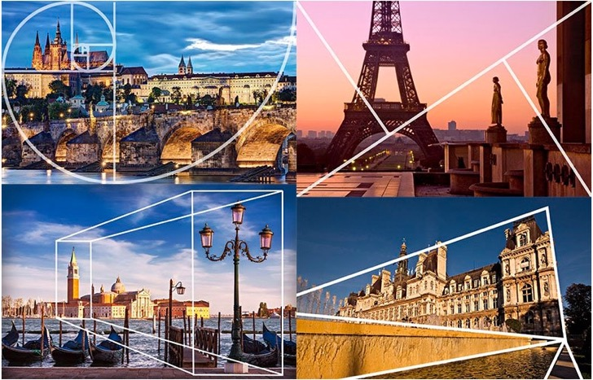
Composition
https://petapixel.com/2016/09/14/20-composition-techniques-will-improve-photos/

Slide 19
Judging
Who can be a Judge in the Simsbury Camera Club (SCC): Judges in the SCC are members of either from Salon or class A.
Judging process for the Simsbury Camera Club (SCC):
For each category, the Judges will have a quick review of each image to be scored. Judging will start when this review is done.
Four (4) judges are needed to score each image.
Each judge will score the image from five (5) to ten (10) based on the Elements of Photography.
The score for each image will be the total of the three (3) highest scores, with the lowest score being removed.
Thus, each individual image will receive a score between fifteen (15) and thirty (30).

Slide 20
Judging
NOTE’S ON SCORING:
In the event that the maker of image being judged is one of the judges, or if the judge is a family member of a judge, that judge will abstain from voting and an average score of the three remaining scores will be used for that judge’s vote in coming up with the total score for the image.
In the event that one the judges, assisted the make of an image, that judge will abstain from voting and an average score of the three remaining scores will be used for that judge’s vote in coming up with the total score for the image.
In the rare event that after scoring an image and hearing all of the comments, a judge may re-score an image if they feel the need to.
In the event of a three point or more disparity in the scoring of an image, after the judges have scored and commented on the image, the judges will be asked to rescore the image based on the comments.

Slide 21
Judging
Image scoring for the Simsbury Camera Club (SCC):
Very Below average: “5” Out of focus (unless intentionally) Over- or under-exposed Not relevant to the theme Snapshot type of picture Little impact or imagination | Below Average: “6” Technically correct (focus, exposure, etc.) Good color for the subject and background Little impact or imagination May be Relevant to the theme | Average: “7” Technically correct Good presentation Good composition Good pictorial treatment Tells a story Relevant to the theme
Above average: “8” Technically correct Good presentation Good composition Good pictorial treatment Tells a story or creates a mood High impact to the viewer Relevant to the theme | Very Above Average: “9” Technically correct in all respects Outstanding composition Tells a complete story or creates a mood High impact to the viewer on first sight Exemplifies the theme | Outstanding: “10” “Knocks your socks off” No Flaws or Room For Improvements

Slide 22
Judging
Judging is not designed to find something wrong.
It is designed to see something right, and then see things that may be improved upon.
Judging is not designed to correct what is wrong, but to suggest what may be done to improve in the future.
The maker must always be left with the impression that the improvement suggested is their choice.

Slide 23
Judging
Personal Bias – Don’t inject your personal bias into the judging and critique of the photograph. We all know that babies and bunnies are cute, but a landscape is just as
beautiful and should be given the same respect. This is probably the hardest thing to leave behind when you judge, just remember you must be fair and be able to justify your score of an image.
The fact that you do not like the subject matter of an image does not give you the right to score the image low.

Slide 24
Judging
Use terms that anchor the analysis to your personal opinion of the image as a Judge, which, after all, is what it is.
Start with:
To me
In my opinion
I feel
I see
I think
Words to avoid:
Always
Never
Must
Should
However
Words to Use:
May
Might
Consider
Version A:
The foreground is out of focus.
Version B:
I think a sharper foreground may have given this photograph a bit more impact.

Slide 25
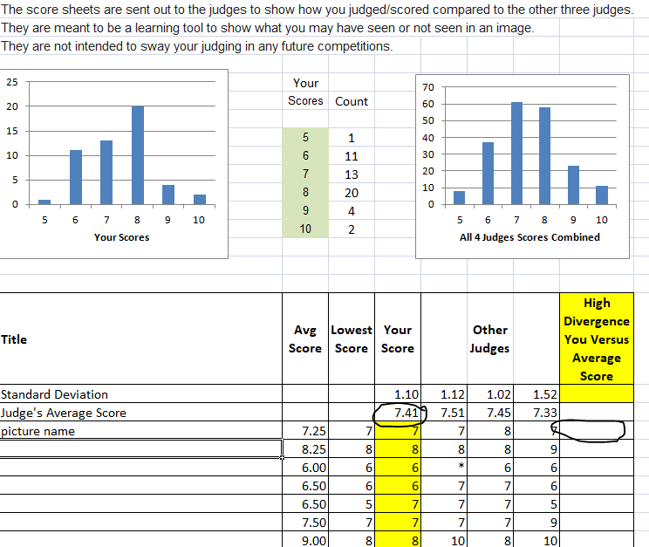
Judging
After every judging
Session, each judge
is sent a Divergence report. This report shows how the judge scored each image as compared to the other three unidentified judges. Graphs are included to show the overall dispersions of individual scores.
The closer to 1.0 on the Standard Deviation indicates a more consistent judging.

Slide 26
Judging
Basic Judging Guidelines for Images:
The Image meets the category requirements
The Image tells a story
The Image has a main focus
The Image has the correct white balance
The Image appears to be level or straight
The Image does not cut off hands or feet
The Image does not have distracting edge artifacts
The Image is not to close to the edge – room to move in the photo
The Image horizon is not in the center of the Image – with the exception of reflections or symmetry
The Image has the subject moving left to right
If needed - The Stroke around the image is thin and a complimentary color
The Images has the WOW factor

Slide 27
Judging
Elements to Judge and Comment on
Impact: Does the image evoke an emotion no matter how subtle?
Story: Does the image tell a story of some kind.
Technical: Focus, depth of field, exposure, camera handling, White Balance, Noise - done well or not?
Composition: How are the subjects in the frame arranged?
Interest area: What, if anything, in the image is of interest to you or not, or is missing?
Creativity: Does the Image convey a different point of view, Focus, use of different lens etc.
Color: How do you see the color being used in the image or not being used?
Light: How has the light been used in the image? Light should enhance an image, not detract from it.
Presentation: Is the image clean without dust spots or other issues?

Slide 28
Judging
Image disqualification
Images may be disqualified for any of the following reasons:
Image appears not to meet the monthly judging criteria
Image previously submitted
Image is not in Good Taste (NECCC Term)
Nature Image that shows the Hand of Man
Any Judge may request that an image be disqualified, however , the judges need to agree. In the event that the judges cannot agree, the judging chairperson has the final word.
There is NO make-up for a disqualified image., however the image may be resubmitted for another competition.

Slide 29
This was an overview of the SCC Judging. The Judges of your club in voluntary cooperation with the Federal, State and local authorities have developed this system to judge your images. If this had been an actual judging, the presentation that you just saw would have been followed by an official judging session. This concludes this presentation.

